Slide 1

ICICI Bank Case Study
Fundamental Analysis of India's Leading Private Sector Bank - Financial Performance & Strategic Outlook
By Anamika Singh

Slide 2




ICICI Bank Overview
Assets
India's second-largest private sector bank with total assets of ₹13.77 trillion
Founded
Established in 1994, headquartered in Mumbai
Business Areas
Retail banking, corporate banking, investment banking, and insurance
Market Position
Second largest private bank with 15.8% credit card market share and 95% transactions online

Slide 3
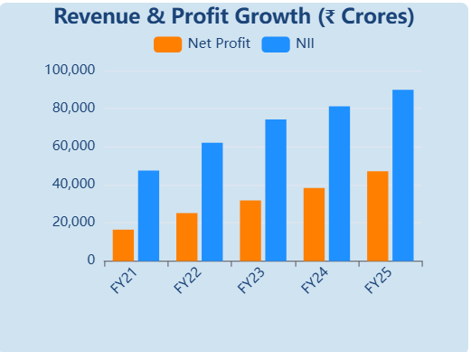
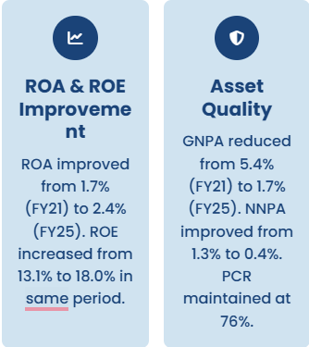
Financial Performance Highlights (2020-2024)

Slide 4
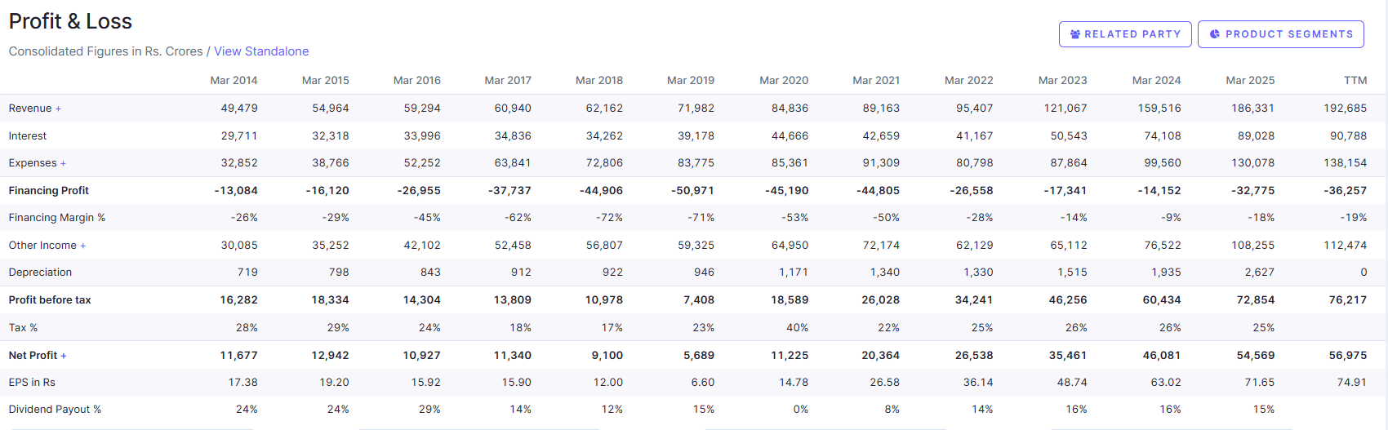
Profit and Loss For ICICI Bank

Slide 5
ICICI Bank SWOT Analysis
Strengths
Strong digital infrastructure with 95% online transactions. Robust capital adequacy at 16.3%. Diversified revenue streams across retail, corporate and investment banking.
Weaknesses
High competition in retail segment. Exposure to unsecured loans at 12.8% of portfolio. NIM pressure due to rising deposit costs.
S
W
Threats
Economic slowdown impacting loan growth. Rising interest rate environment pressuring margins. Increasing fintech competition and regulatory changes.
T
O
Opportunities
Digital banking expansion in rural areas. Growing SME and business banking segment (34% YoY growth). Credit card market share expansion opportunities.

Slide 6
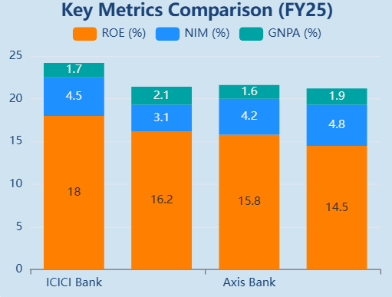
Peer Comparison Analysis
Competitive Positioning
ICICI Bank leads in profitability metrics with highest ROE at 18% and strong NIM at 4.5%. Asset quality remains superior with GNPA at 1.7%, better than SBI's 2.1%. Market cap of ₹9.83 lakh crore positions it as second largest private bank.

Slide 7
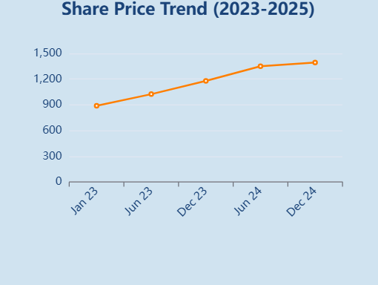
Stock Performance & Outlook
Investment Thesis
ICICI Bank demonstrates strong fundamentals with consistent profit growth of 39.8% CAGR over 5 years. Current P/E of 20.8x offers reasonable valuation. Digital initiatives and business banking growth provide future catalysts.
3.96
1-Year Return

Slide 8
Growth Strategy & Digital Initiatives
1 2 3 4 5
Digital Banking Expansion
95% transactions now digital
Business Banking Growth
34% YoY growth in SME segment
Branch Network Expansion
6,500+ branches across India
Technology Investments
₹10,000+ crore in digital infrastructure
Partnership Strategy
Collaborations with fintech companies and digital payment platforms

Slide 9
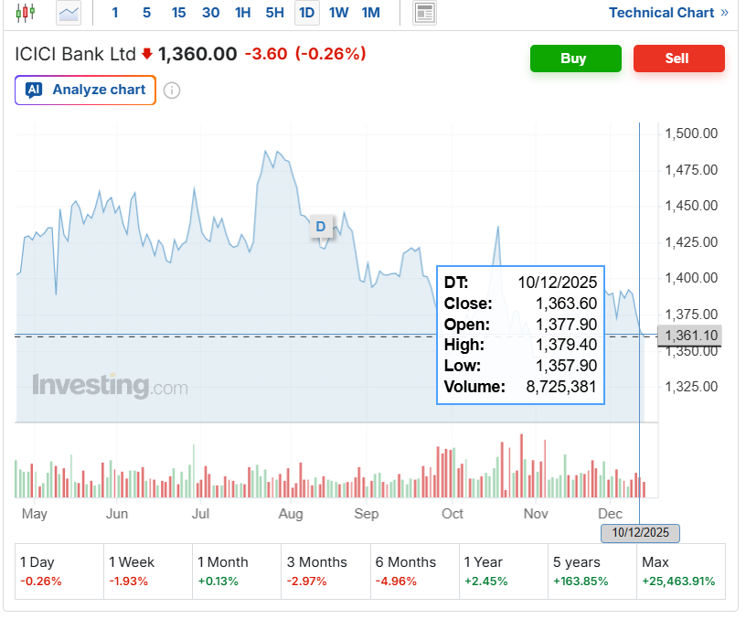
Key Financial Ratios & Capital Adequacy
CAR
Capital Adequacy Ratio at 16.3% well above RBI requirement of 11.5%
ROA
Return on Assets improved to 2.4% from 1.7% in FY21
Cost-to-Income
Ratio optimized to 42.3%
Credit-Deposit
Ratio maintained at 88.7% indicating healthy lending growth

